Slide 1
RAJALAKSHMI ENGINEERING COLLEGE
Department of Information Technology
AN EFFICIENT HEALTHCARE MONITORING AND PRE-EMPTIVE AMBULACE CONTROL THROUGH TRAFFIC SIGNALS
Project by,
VASANTHAN V(211616205108)
SELVABHARATHI S(211616205094)
TEJA SAI VIGNESH D(211616205106)
Supervisor
Mrs. SREE SUBHA S

Slide 2
OUTLINE
Objectives
Abstract
Introduction to Problem Domain
Existing system
Limitation of the Existing System
Proposed system
Architectural design for Proposed system
ER ,Use case Diagram
Algorithm/Technique Used
Expected Outcomes
References

Slide 3
OBJECTIVE
To monitor the oxygen, temperature, pulse , BPM of a person in emergency .
The monitoring is done in the stretcher itself so the monitoring of data is not lost when the person is shifted from the stretcher to the emergency ward
To eliminate the waiting time of ambulance in traffic signals.

Slide 4
ABSTRACT
Monitoring the pulse, heart beat rate and oxygen levels of a person in an ambulance and then shifting the person to the emergency ward and then continuing the monitoring is what being done usually.
The monitoring is stopped in the time when the person is shifted from the ambulance and admitted in the emergency ward. This is a big disadvantage because there is chance of drop in oxygen or pulse levels at any particular time.
We eliminate this disadvantage by installing pulse sensor , temperature sensor , pressure sensor , gas sensor in the stretcher itself and all these can be connected to a person’s body and can be monitored continuously .
All these data are displayed in a webpage using IOT. The same stretcher can be used in emergency ward and the data of the person is not lost at any time period.
A mobile app with IOT controllers which continuously sends/receive the next nearest signal and enable the driver to control the signal by changing the traffic lights, at this moment, the precedence of traffic lights are given to the ambulance driver, once he passes away the signal, he may turn it to normal, Therefore the ambulance can reach the hospital soon .
KEYWORDS : IOT , pressure , pulse , mobile app, temperature

Slide 5
INTRODUCTION TO PROBLEM DOMAIN
Traffic jams is one of the crucial issue in India due to which ambulance services get affected on large amount, due to delay in ambulance service, patient may lose his life and number of these scenarios are getting increased day by day.
Also once a patient is arrived to the hospital it take some time to create a report and data for that patient, these all things plays a major time in the patient’s life going situation.
What if we have a automation to generate reports, and live data monitoring of patients health and traffic clear road for ambulance, in together.
In this project we concentrated on these problems and developed a system with IOT, Mobile APP, Wireless technology, Security Mechanism
We name this mobile application as “Arista”.

Slide 6
EXISTING SYSTEM
The pulse , BPM, temperature , oxygen levels are all calculated within the ambulance .
Ambulance carries the person and drives through a normal route and waits in the traffic signal.
RFID Traffic controller is introduced.
Using GPS, location of signal and ambulance is introduced.

Slide 7
LIMITATIONS OF EXISTING SYSTEM
The data is lost when the person is shifted from stretcher to the ambulance
Ambulance need to wait in the traffic signal till it turns green
Wastage of time and not monitoring the data in the time internal of arrival of ambulance till the admission time
Using GPS location of signal and ambulance, it is very tedious to select a particular signal, when it splits to four or three way, As the GPS coordinates lies in the same place.
In RFID Traffic controller, the disadvantage is, the RFID reader should be scanned only when the ambulance reach the RFID reader spot, if it is unable to reach, the signal, can’t be changed.

Slide 8
PROPOSED SYSTEM
The stretcher has pulse sensor, temperature, pressure and gas sensors attached along with it .
The sensors on the stretcher can be connected to the person placed on the stretcher .
The same stretcher is carried into the emergency ward .
This ensures that the data is not missed anywhere . Continuous monitoring of oxygen , pulse and temperature of a person easily facilitates the doctor to give the suitable treatments .

Slide 9
PROPOSED SYSTEM
We have a kit for the ambulance driver, and install a kit in traffic signal zone.
The kit, which ambulance driver has, contains NRF and Bluetooth module with a UART micro-controller(Arduino-Uno) controlling them, it allow the ambulance driver to connect his mobile device to the kit.
The driver will have an app, which can show up the signal, which is upcoming to him. And allow him to select the way he want to go.
On selecting the way, the traffic light will be changed, As we have another NRF and Arduino kit in the signal zone, this kit will beacon the available number of signal and notify to the kit in ambulance which is connected to the driver’ mobile app.
We also concern safety of this wireless Transmission/Reception, which we don’t want to be interfused with other devices, So we apply Caesar cipher Encryption technique to prevent from hackers who can de-authenticate the signal’s beacon services.
The traffic signal located on the way of the ambulance is turned on green till the ambulance passes through .

Slide 10
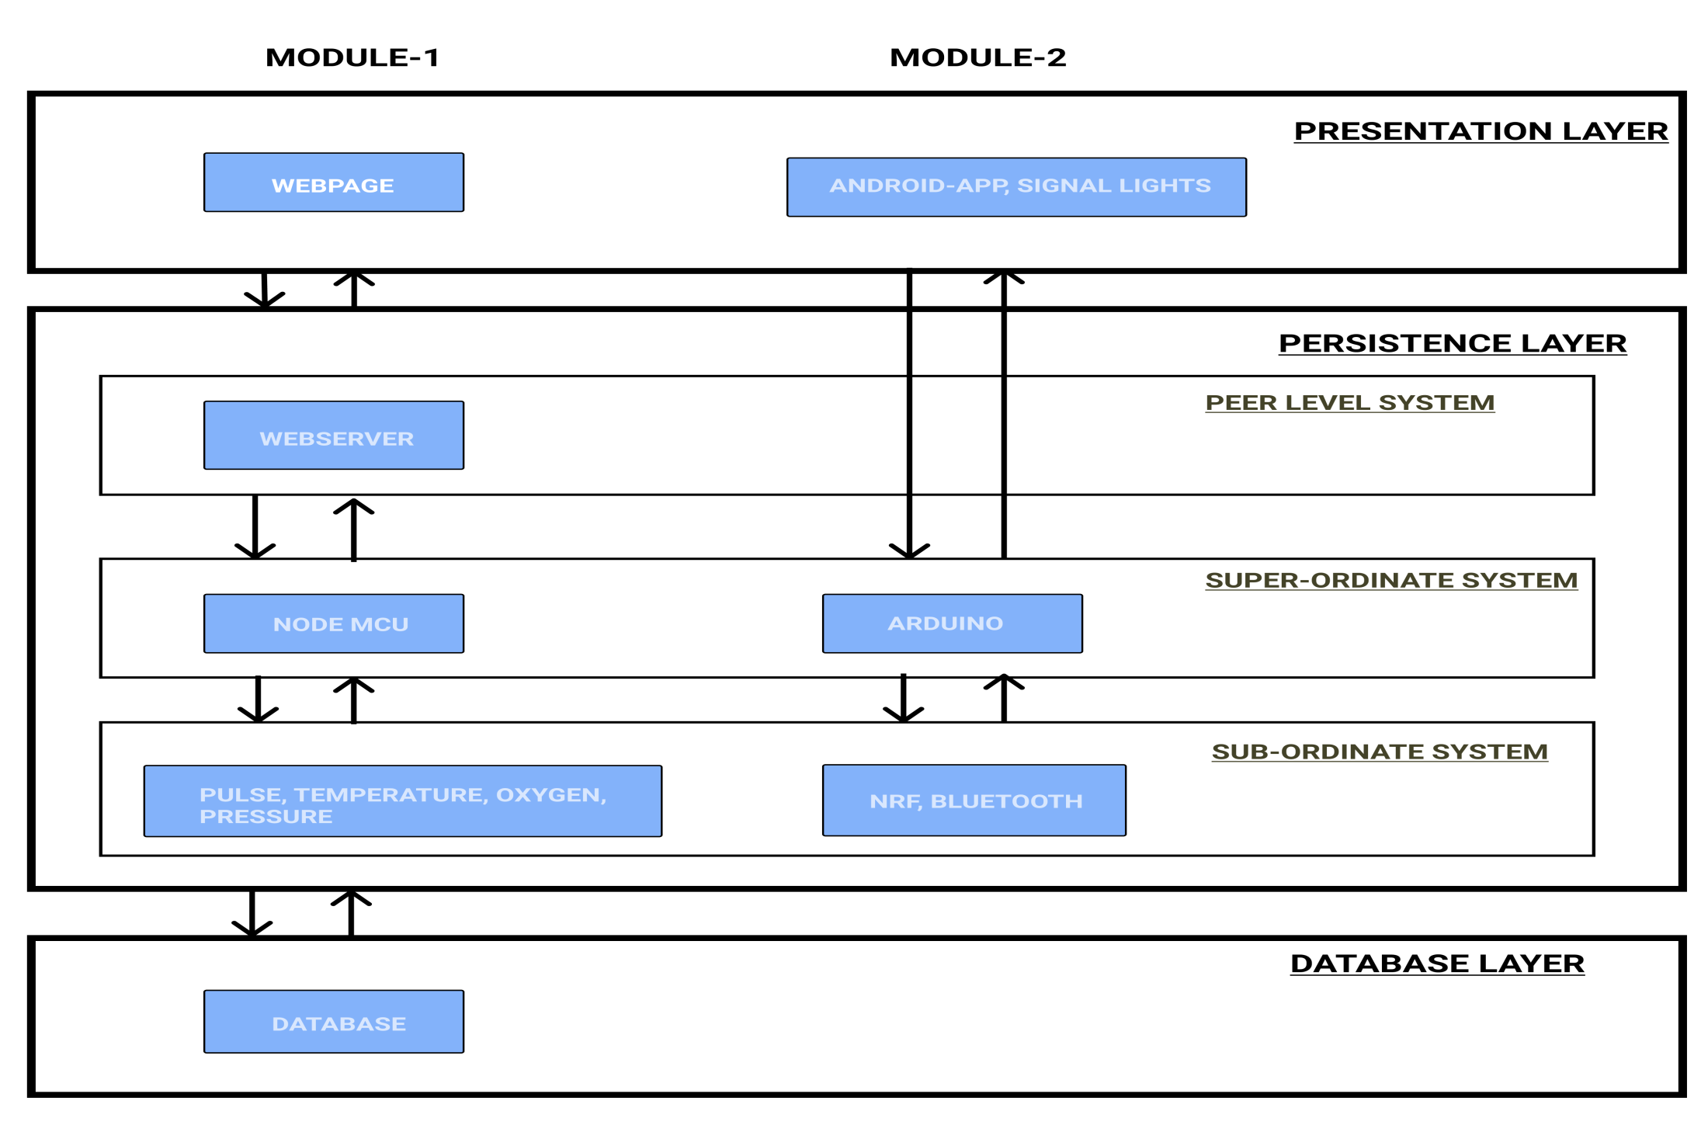
ARCHITECTURAL DESIGN FOR PROPOSED SYSTEM

Slide 11
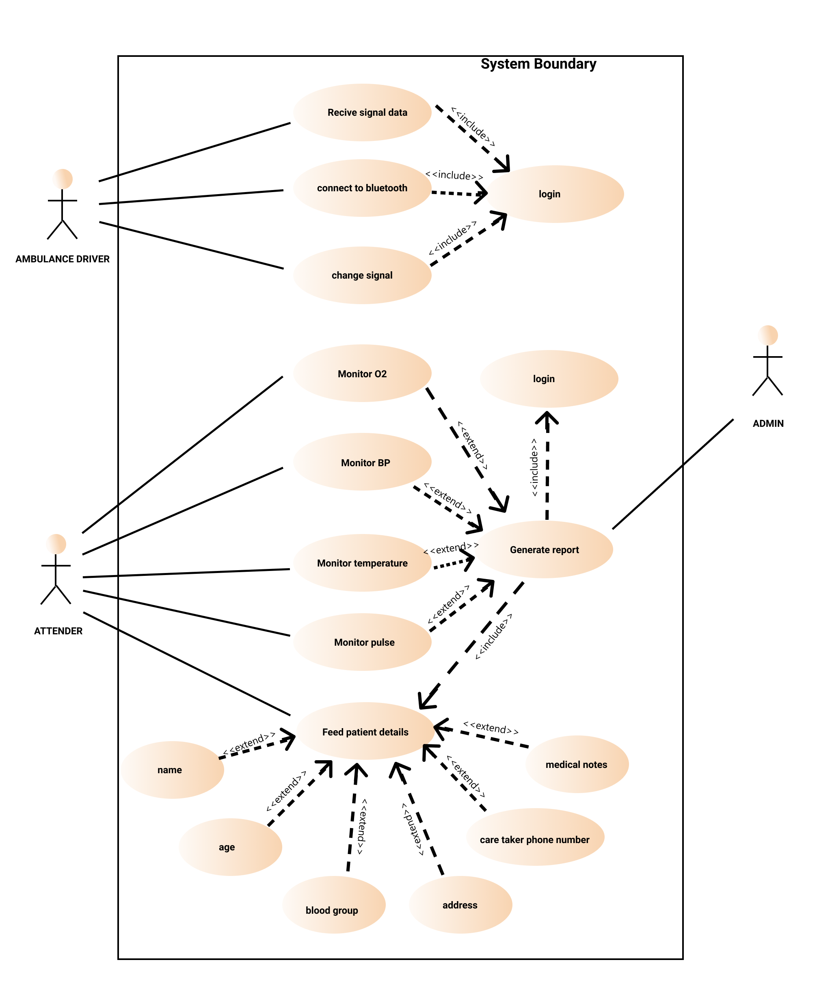
ER/ USE CASE DIAGRAM

Slide 12
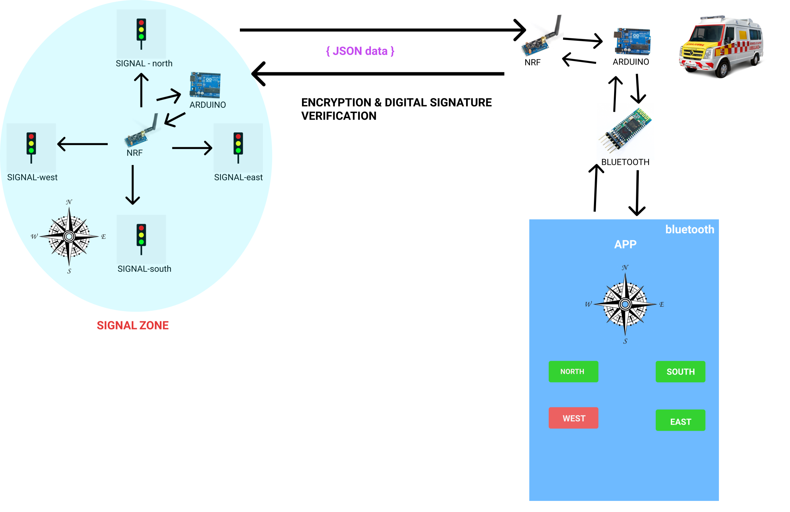
ER/ USE CASE DIAGRAM

Slide 13
EXPECTED OUTCOMES
We use pulse sensor to calculate the pulse of a person and display in a webpage
We use temperature sensor and pressure sensors to calculate the temperature and pressure of a person and display in a webpage .
The traffic signals located on the way of the ambulance turns green until the ambulance passes through it .

Slide 14
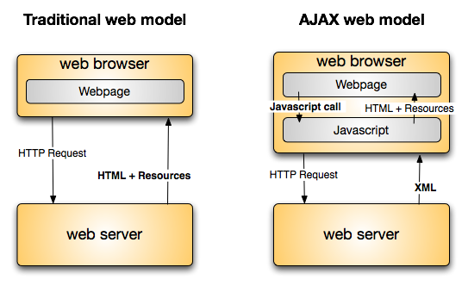
ALGORITHM/ TECHNIQUE USED
Software used : Arduino IDE, Android Studio
Framework used : Json, Ajax.
Sensor used : NRF, Bluetooth, pulse, temperature, gas, pressure sensors
Micro controller : Arduino Uno R3, Node MCU.
Algorithm : Caesar Cipher Encryption technique

Slide 15
ALGORITHM/ TECHNIQUE USED
CEASAR CIPHER
It is a type of substitution cipher in which each letter in the plaintext is shifted a certain number of places down the alphabet.
For encrypting:
C(x) = (x+k) mod 26
For Decrypting:
P(x)=(x-k)mod26
Where, C(x) is the ciphertext
P(x) is the plaintext
x is the plaintext
k is the number of shift

Slide 16
ADVANTAGE OF PROPOSED SYSTEM
We ensure that the patient health condition is monitored every second and report the details of his condition to the hospital, as a live data through IOT techniques.
With this the doctors can guide the attendees present in the ambulance to give the right first aids, and any other measures.
The driver can easily drive fast to the hospital without any traffic conjunction, as he has the priority to change the traffic signal with his mobile app.

Slide 17
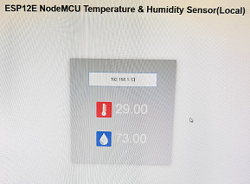
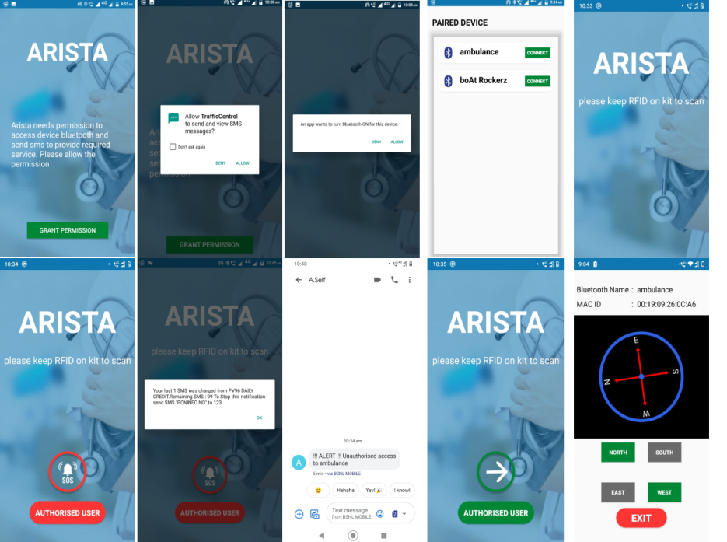
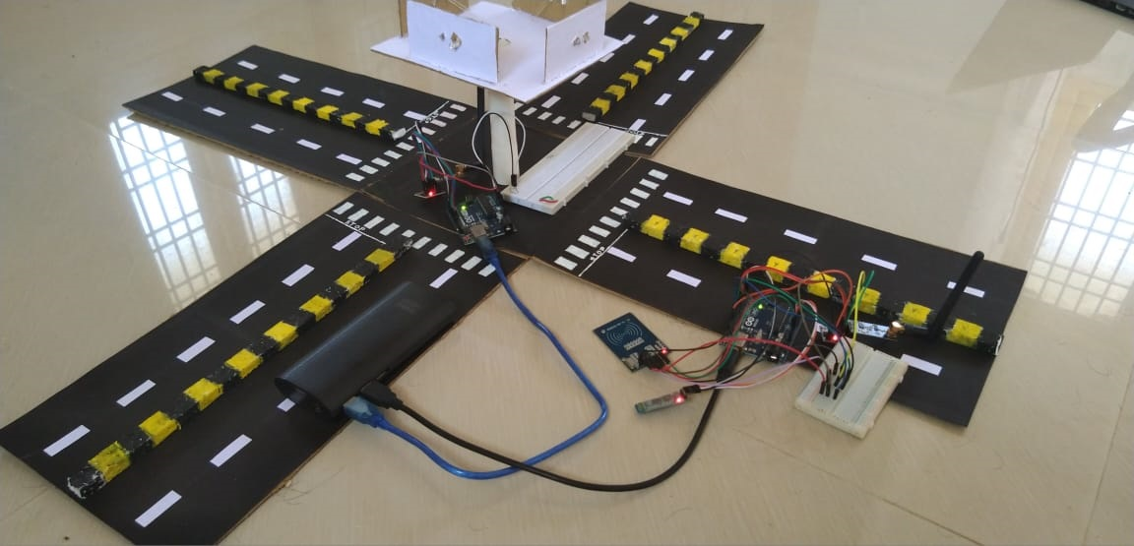
RESULTS

Slide 18
REFERENCES
References in IEEE Format
[1] Health monitoring System for ambulance
(IJRASET) Volume 7 Issue 6
Arpita K.M , Janvi Maddi , Ashwan T, Asha K.S
[2] IoT Based Ambulance vital Signs Data Transfer
Syed Misahuddin , Junaid ahmed zubairi
[3] An IOT based ambulance Tracking with Patient Health Monitoring System Using GPS and GSM
Qurrat UI Aryan , Veena Saraf
[4] Emergency medical services in Internet of Things
A.Elangeswari , R . Poorni
[5] Smart Ambulance Rescue System with Patient Health Monitoring Using IoT
Irin Sherley S, Mariam Sohitam Princy A.
[6] IoT Based ECG Monitoring in Versatile Ambulance system
S.Sathyamoorthy , Anupama , Akshaya
[7] IoT Ambulance with Automatic Traffic Light Control
S.N Sivaraj , K . Vigneshwaran , M. Vishnu Priyan

Slide 19
THANK YOU

